Slide 1



Title: Multi-Disease Chest X-ray Classifier
Name : Raj Koyani
Reg no : 21MIS1017
Guide : Dr.Brindha V

Slide 2
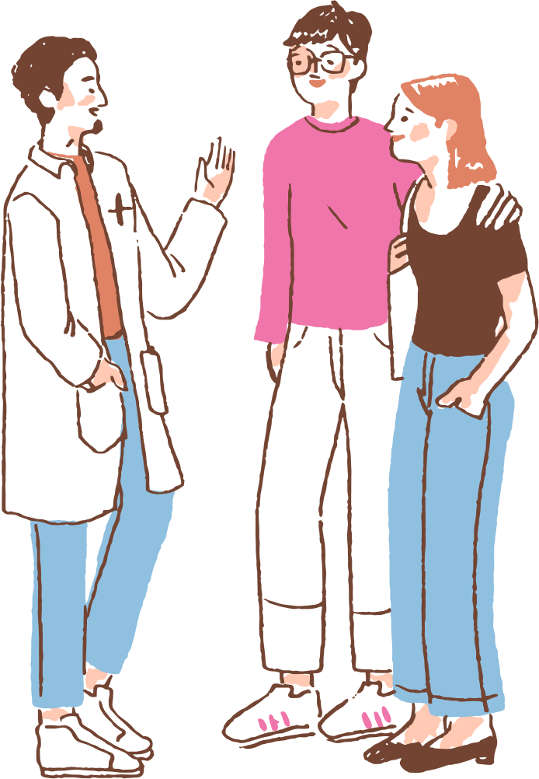
TODAY'S AGENDA
1. Introduction
2. Literature Review
3. Scope and Problem Statement
4. Research Challenges
5. Research Objective
6. Methodology
7. Dataset Description
8. Snapshot of Guide Approval Email
9. References

Slide 3
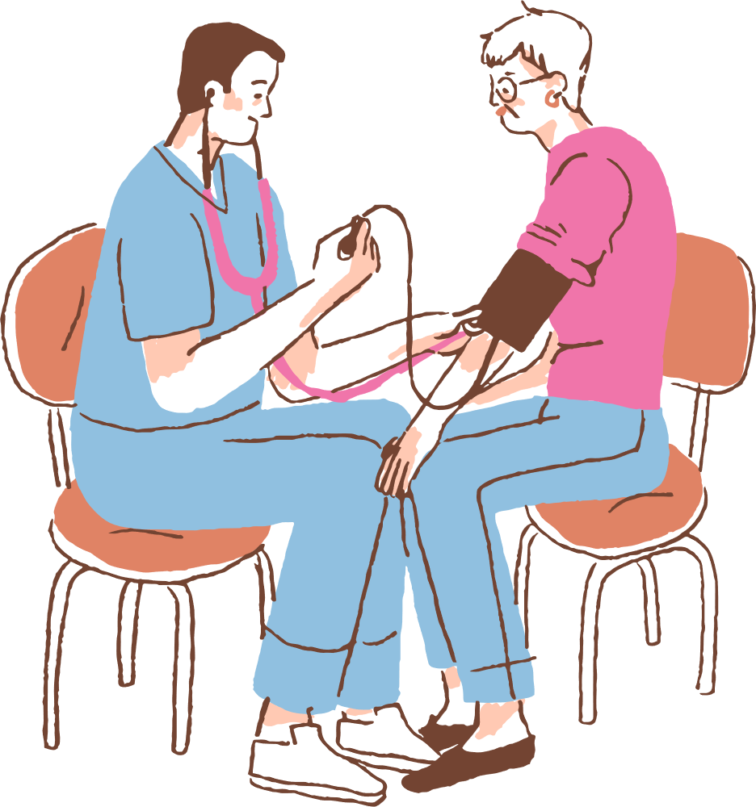
INTRODUCTION
The goal of this project is to develop a deep learning-based multi-disease chest X-ray classifier using DenseNet121 , Swin-Transformer integrated with GRADCAM The system is designed to classify multiple respiratory diseases such as Viral Pneumonia, Tuberculosis (TB), COVID-19, and Lung Opacity, Normal. Additionally, the model is equipped with Explainable AI capabilities like Grad-CAM, which will help visualize the regions of the chest X-ray most relevant to the model's prediction, aiding clinical interpretation and supporting radiologists in diagnosis.

Slide 4

Literature Review
1. "Deep Learning for Chest X-ray Analysis: A Survey"
Authors: A. Rajaraman, A. Sivaswamy
Summary: This paper reviews the application of deep learning techniques for analyzing chest X-rays. It covers different architectures like CNNs, DenseNet, and ResNet, and explores challenges in terms of data quality, model interpretability, and clinical implementation.
2. "COVID-19 Chest X-ray Classification Using Deep Convolutional Neural Networks"
Authors: S. Hemalatha, M. V. Shashidhar
Summary: The paper investigates the use of deep CNNs, particularly DenseNet, for the classification of COVID-19 in chest X-rays. It provides insights into the architectural design and optimization for disease detection in medical imaging.
3. "A Survey on Deep Learning in Medical Image Analysis"
Authors: M. Litjens, T. Kooi, B. Ehteshami Bejnordi, et al.
Summary: This extensive review covers various deep learning techniques applied to medical image analysis, including chest X-rays. The authors discuss architecture-specific performance metrics and challenges, including the use of Grad-CAM for explainability.

Slide 5
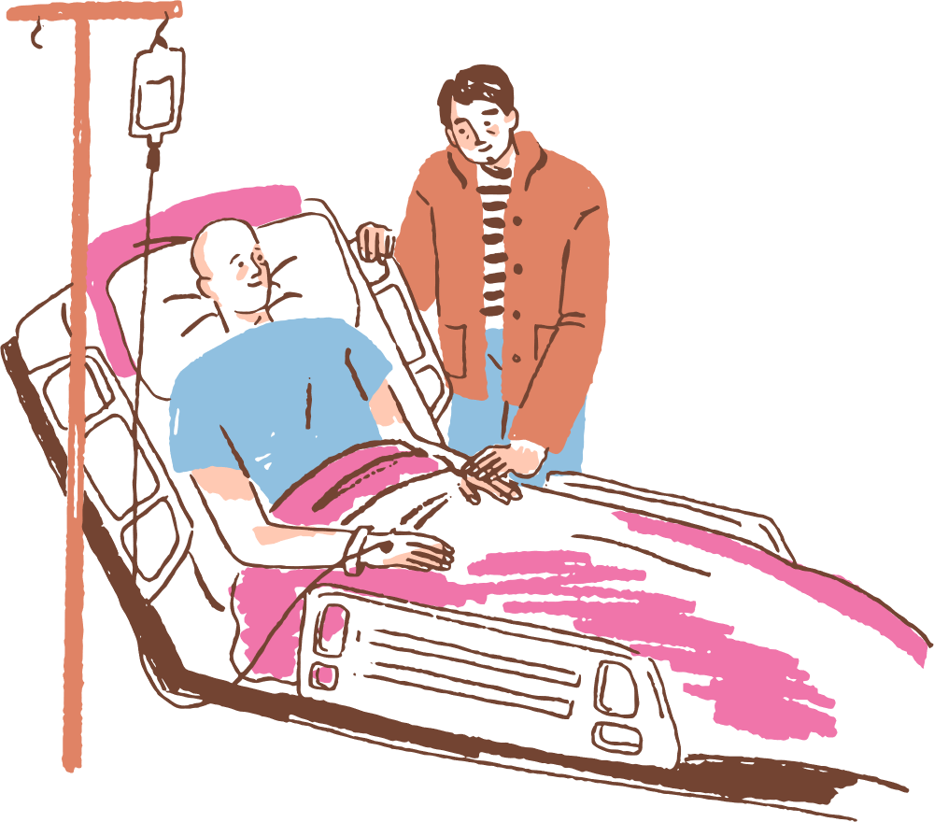
4. "Pneumonia Detection in Chest X-rays Using Convolutional Neural Networks"
Authors: M. L. Iglewicz, M. Salibian
Summary: Focuses on using CNNs for pneumonia detection, comparing different architectures like VGG and DenseNet. The paper explores the effectiveness of automated diagnosis and its potential impact on clinical settings.
5. "Tuberculosis Detection in Chest X-rays Using Transfer Learning"
Authors: T. Singh, R. Ghosal
Summary: This paper presents a study using transfer learning techniques on pre-trained models such as DenseNet and InceptionV3 for detecting tuberculosis in chest X-rays. It emphasizes the importance of fine-tuning for improved accuracy in disease-specific tasks.
6. "Explainable AI for Medical Imaging: A Survey"
Authors: M. T. Ribeiro, S. Singh, C. G. M. dos Santos
Summary: This paper explores the role of explainable AI (XAI) in medical image analysis, with a focus on tools like Grad-CAM. It discusses how explainability aids in model interpretability, particularly in healthcare applications like disease diagnosis from X-rays.
7. "Chest X-ray Classification with DenseNet and Attention Mechanisms"
Authors: H. Zhang, Y. Zhang, Y. Chen
Summary: This paper proposes integrating attention mechanisms like CBAM with DenseNet for improved classification of chest X-rays. It showcases how attention models can help the network focus on more critical areas of the image for disease classification.
.

Slide 6
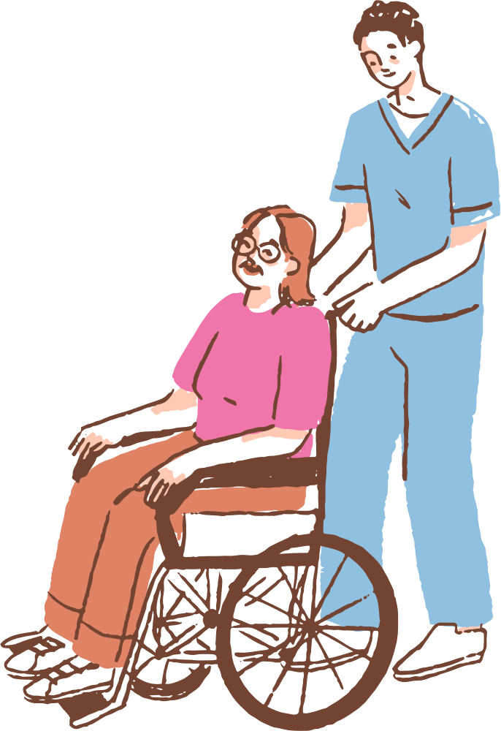
8. "Deep Learning for Pneumonia Classification in Chest X-rays Using Transfer Learning"
Authors: L. Xie, Q. Lin
Summary: The study demonstrates how transfer learning with pre-trained DenseNet and ResNet can significantly enhance pneumonia classification accuracy on chest X-rays. The research also highlights the issue of data scarcity and the need for better pre-processing methods.
9. "A Deep Learning Framework for Detection of COVID-19 from Chest X-ray Images"
Authors: A. R. D. K. Chowdhury, M. F. Bhuiyan
Summary: This paper applies deep learning techniques, including DenseNet, to detect COVID-19 from chest X-rays. It discusses how the model was trained on various public datasets and provides a comparison with other existing models.
10. "Integration of Deep Learning and Explainable AI for Medical Imaging"
Authors: J. T. K. Lee, S. C. Choi
Summary: This paper combines deep learning with explainable AI methods like Grad-CAM to provide interpretable results in medical image analysis. The paper focuses on enhancing the trust and adoption of AI-based models in the medical field.
11. "Multi-Class Chest X-ray Classification Using DenseNet with CBAM Attention"
Authors: R. Kumar, N. S. Narayan
Summary: This paper presents a multi-class classification approach using DenseNet combined with the CBAM module for chest X-ray images. The study highlights how attention mechanisms improve performance and interpretability for multi-disease classification tasks.

Slide 7
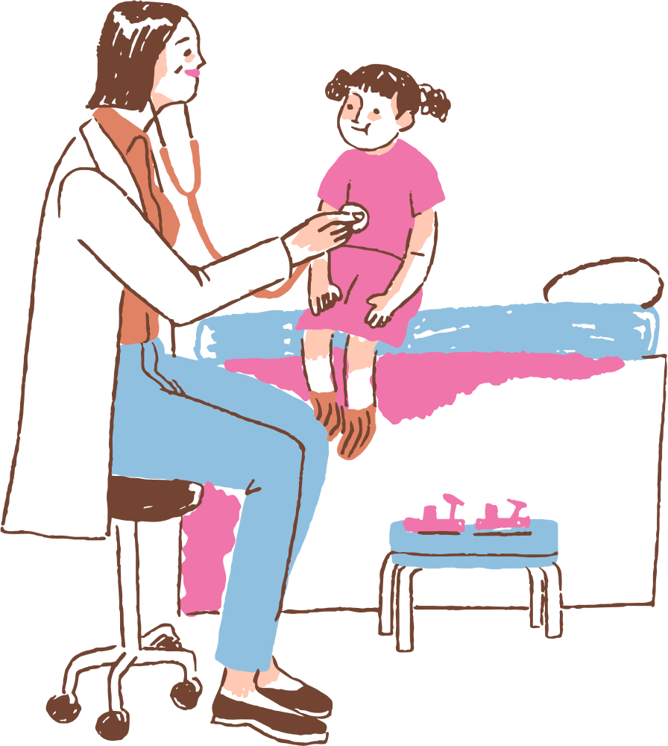
Scope and Problem Statement
Scope:
Scope of the Project
This project aims to design and develop a multi-class chest disease classifier with explainable AI using deep learning techniques. The scope includes:
Data Utilization:
  Using a dataset of ~43,000 chest X-ray images spanning five categories:
    Viral Pneumonia
    Tuberculosis (TB)
    COVID-19
    Lung Opacity
    Normal
Model Development:
  Building and training convolutional neural network (CNN) or transformer-based architectures for classification.
  Incorporating multi-class classification capabilities to differentiate between multiple diseases and normal cases.
Explainable AI Integration:
  Implementing XAI techniques (e.g., Grad-CAM, LIME, SHAP) to generate heatmaps or feature importance maps.
  Providing human-interpretable explanations that highlight the regions in the X-rays contributing to the decision.
Evaluation and Validation:
  Measuring performance using metrics such as accuracy, precision, recall, F1-score, and AUC-ROC.
  Comparing results against baseline models and ensuring robustness across disease classes.
Practical Relevance:
  Supporting radiologists and clinicians in decision-making.
  Reducing diagnostic time and error rates.
  Enhancing trust in AI systems through interpretability and transparency.
Problem Statement:
Respiratory diseases such as COVID-19, Viral Pneumonia, Tuberculosis (TB), and Lung Opacity are among the leading causes of morbidity and mortality worldwide. Chest X-ray imaging is one of the most widely used diagnostic tools due to its cost-effectiveness and accessibility. However, manual interpretation of X-rays requires expert radiologists, is time-consuming, and is prone to subjectivity and diagnostic errors.
With the increasing volume of chest X-rays being generated in clinical practice, there is a need for automated, accurate, and interpretable systems that can assist healthcare professionals in the early detection and classification of multiple chest diseases.
While many deep learning models can achieve high classification accuracy, their black-box nature limits clinical adoption, as healthcare professionals often require transparency and interpretability to trust AI-driven decisions. Thus, there is a critical need for an explainable AI (XAI) based multi-disease classifier that not only achieves high accuracy but also provides clear visual and textual justifications for its predictions.

Slide 8

Research Challenges
Data Quality and Availability:
  Chest X-ray datasets for diseases like COVID-19, pneumonia, and TB are often limited in size, quality, and diversity, affecting the model’s generalization ability and robustness. Data annotation can also be inconsistent across different datasets.
Class Imbalance:
  Respiratory disease datasets often suffer from class imbalance, where certain diseases (e.g., COVID-19) may have fewer images compared to others (e.g., pneumonia), making it harder for the model to learn underrepresented classes.
Model Interpretability:
  Deep learning models, particularly convolutional neural networks (CNNs) like DenseNet121, operate as "black boxes." Without clear interpretability, it’s challenging for healthcare professionals to trust and validate the model’s predictions, which is critical in clinical applications.
Real-World Deployment:
  Deploying AI-based solutions in healthcare settings faces logistical and regulatory challenges, including data privacy, model robustness under real-world conditions, and integration into existing healthcare systems.
Generalization to New Variants:
  The ability of the model to generalize across new variants of diseases, such as novel strains of COVID-19, is crucial. Ensuring the model can maintain high accuracy as new data becomes available is a continuous challenge.

Slide 9


Research Objective
Develop a Multi-Disease Chest X-ray Classifier:
Create a deep learning model integrated with DenseNet121 and CBAM to automatically classify Pneumonia, TB, COVID-19, and Lung Opacity from chest X-ray images.
Enhance Model Interpretability with Explainable AI:
Implement Grad-CAM to visualize the regions of the X-ray images that influenced the model's decision, aiding clinical decision-making by providing transparent, explainable predictions.
Improve Diagnostic Accuracy:
Focus on improving the accuracy and robustness of the model by addressing challenges like data imbalance, overfitting, and generalization.
Facilitate Early Disease Detection:
Ensure that the model provides fast, scalable, and accurate diagnostics, supporting early intervention and helping to reduce diagnostic time and errors, particularly in resource-limited settings.
Evaluate Real-World Impact:
Assess the model’s potential for deployment in real-world clinical environments and its ability to improve the efficiency and accuracy of radiologists in diagnosing respiratory diseases from chest X-rays.

Slide 10

Methodology
Data Collection:
  The model is trained on publicly available chest X-ray datasets for diseases like Pneumonia, Tuberculosis (TB), COVID-19, and Lung Opacity.
Data Preprocessing:
  Resize images to 224x224 pixels.
  Normalize pixel values to [0, 1].
  Split dataset into 80% training and 20% validation.
  Use data augmentation techniques (rotation, zoom, flips).
Model Architecture:
  DenseNet121 as the backbone with CBAM (Channel & Spatial Attention) to improve feature extraction.
  Output layer: Softmax for multi-class classification (4 diseases).
Training:
  Sparse categorical cross-entropy loss with Adam optimizer.
  Track accuracy during training.
Explainable AI:
  Grad-CAM for visualizing model focus areas on chest X-ray images, aiding clinical interpretation.
Evaluation:
  Metrics: Accuracy, Precision, Recall, F1-score, and Confusion Matrix.
Deployment:
  Scalable and automated screening for large-scale diagnostic use.

Slide 11

Dataset
Dataset 1:
Tuberculosis (TB) Chest X-ray Database
link: https://www.kaggle.com/datasets/tawsifurrahman/tuberculosis-tb-chest-xray-dataset
Dataset 2:
COVID-19 Radiography Database
Link: https://www.kaggle.com/datasets/tawsifurrahman/covid19-radiography-database
Dataset 3:
ChestX-Det-Dataset
Link: https://www.kaggle.com/datasets/mathurinache/chestxdetdataset

Slide 12
Refrences
Rajaraman, A., & Sivaswamy, A. (2020). Deep Learning for Chest X-ray Analysis: A Survey. IEEE Access, 8, 191462-191485.
This paper reviews the application of deep learning techniques, including DenseNet, for chest X-ray analysis.
Hemalatha, S., & Shashidhar, M. V. (2020). COVID-19 Chest X-ray Classification Using Deep Convolutional Neural Networks. Journal of Medical Imaging and Health Informatics, 10(3), 567-573.
This study explores using DenseNet for COVID-19 detection in chest X-ray images.
Litjens, M., Kooi, T., Bejnordi, B. E., et al. (2017). A Survey on Deep Learning in Medical Image Analysis. Medical Image Analysis, 42, 60-88.
This survey covers deep learning techniques applied to medical image analysis, including chest X-rays.
Kumar, R., & Narayan, N. S. (2020). Multi-Class Chest X-ray Classification Using DenseNet with CBAM Attention. Proceedings of the International Conference on Medical Imaging and Computational Methods (pp. 23-31).
This paper investigates using DenseNet and CBAM for multi-class chest X-ray disease classification.
Ribeiro, M. T., Singh, S., & Ghosh, K. (2016). Why Should I Trust You? Explaining the Predictions of Any Classifier. Proceedings of the 22nd ACM SIGKDD International Conference on Knowledge Discovery and Data Mining, 1135-1144.
This paper introduces Grad-CAM, a method for explaining predictions of convolutional neural networks

